Slide 1

Reverse Engineering: A Quantitative Analysis on the 7-Letter Scoring Scheme’s Efficacy in mRNA Vaccine Designs
Junyou (Simon) Li

Slide 2
Good Evening
Notes:
Good Afternoon, fellow students and panelists. My name is Simon Li, and welcome to my presentation and oral defense.

Slide 3
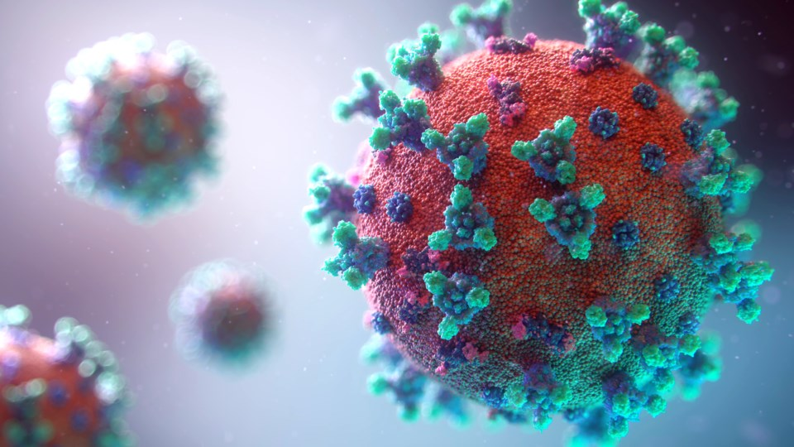
Notes:
Approximately a year and a half ago, the COVID-19 pandemic broke out. I initially thought it was nothing serious, but it soon spread across country and infected thousands of people.

Slide 4

Notes:
Wuhan was locked down and flights were cancelled. I started to become worried, about my grandmother who’s living near Wuhan and all the other people who could be endangered by the virus, hoping that the vaccine would soon come out and save the world.

Slide 5
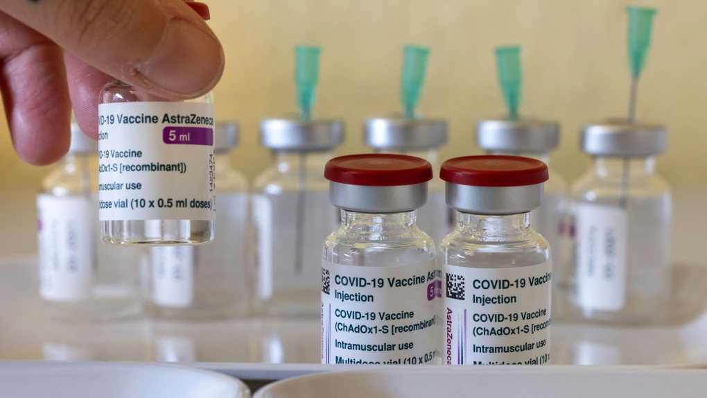
Notes:
However, when the vaccine eventually came out, there were still concerns on the side effects of the vaccine such as blood clot. As an aspiring STEM student, I became curious in how the pharmatheutical companies are designing vaccines. However, there was zero information on the internet about the vaccine design. And thus, prompted to this research question.

Slide 6
Research Question
How could 7-Letter Scoring Scheme implemented in Nussinov and Jacobson model optimize the Minimum Free Energy and Codon Adaptation Index of mRNA COVID-19 vaccine designs?

Slide 7
Definition
How could 7-Letter Scoring Scheme implemented in Nussinov and Jacobson model optimize the Minimum Free Energy and Codon Adaptation Index of mRNA COVID-19 vaccine designs?
a dynamic programming algorithm for finding the most stable secondary structures in long single-stranded RNAs (Nussinov & Jacobson, 1980)

Slide 8
Definition
How could 7-Letter Scoring Scheme implemented in Nussinov and Jacobson model optimize the Minimum Free Energy and Codon Adaptation Index of mRNA COVID-19 vaccine designs?
a dynamic programming algorithm for finding the most stable secondary structures in long single-stranded RNAs (Nussinov & Jacobson, 1980)
a programming technique that leverages previous computations to save computation time (Bellman, 1966)

Slide 9
Definition
How could 7-Letter Scoring Scheme implemented in Nussinov and Jacobson model optimize the Minimum Free Energy and Codon Adaptation Index of mRNA COVID-19 vaccine designs?
Notes:
To understand what is a 7-letter scoring scheme, it is imperative to understand what is 7-letter.

Slide 10
Definition
How could 7-Letter Scoring Scheme implemented in Nussinov and Jacobson model optimize the Minimum Free Energy and Codon Adaptation Index of mRNA COVID-19 vaccine designs?

Slide 11
Definition
How could 7-Letter Scoring Scheme implemented in Nussinov and Jacobson model optimize the Minimum Free Energy and Codon Adaptation Index of mRNA COVID-19 vaccine designs?
A C G U
Notes:
And in a RNA sequence, 3 nucleotides consist of an amino acid, which is the building block to make a protein.

Slide 12
Definition
How could 7-Letter Scoring Scheme implemented in Nussinov and Jacobson model optimize the Minimum Free Energy and Codon Adaptation Index of mRNA COVID-19 vaccine designs?
A C G U R Y N
Notes:
I have added three additional alphabets, R Y and N,

Slide 13
Definition
How could 7-Letter Scoring Scheme implemented in Nussinov and Jacobson model optimize the Minimum Free Energy and Codon Adaptation Index of mRNA COVID-19 vaccine designs?
A C G U R Y N
Notes:
in which R stands of purine, which is (G or A),

Slide 14
Definition
How could 7-Letter Scoring Scheme implemented in Nussinov and Jacobson model optimize the Minimum Free Energy and Codon Adaptation Index of mRNA COVID-19 vaccine designs?
A C G U R Y N
Notes:
Y stands for pyrimidine, which is C or U,

Slide 15
Definition
How could 7-Letter Scoring Scheme implemented in Nussinov and Jacobson model optimize the Minimum Free Energy and Codon Adaptation Index of mRNA COVID-19 vaccine designs?
A C G U R Y N
Notes:
and N, which is any nucleotides.

Slide 16
Definition
How could 7-Letter Scoring Scheme implemented in Nussinov and Jacobson model optimize the Minimum Free Energy and Codon Adaptation Index of mRNA COVID-19 vaccine designs?
A C G U R Y N
Notes:
The reason why these three are added is to represent all the synonymous codons with one single codon.

Slide 17
Definition
How could 7-Letter Scoring Scheme implemented in Nussinov and Jacobson model optimize the Minimum Free Energy and Codon Adaptation Index of mRNA COVID-19 vaccine designs?
A C G U R Y N
Synonymous Codons
Notes:
To understand what is synonymous codons, we need to understand what is a codon.

Slide 18
Definition
How could 7-Letter Scoring Scheme implemented in Nussinov and Jacobson model optimize the Minimum Free Energy and Codon Adaptation Index of mRNA COVID-19 vaccine designs?
AGU
Codon
Notes:
In a sequence, three nucleotide becomes a codon.

Slide 19
Definition
How could 7-Letter Scoring Scheme implemented in Nussinov and Jacobson model optimize the Minimum Free Energy and Codon Adaptation Index of mRNA COVID-19 vaccine designs?
AGU
Codon
S
Amino Acid
Notes:
A codon can be translated into an amino acid.

Slide 20
Definition
How could 7-Letter Scoring Scheme implemented in Nussinov and Jacobson model optimize the Minimum Free Energy and Codon Adaptation Index of mRNA COVID-19 vaccine designs?
AGU
Codon
S
Amino Acid
M V V S W Q E
Protein
Notes:
And the amino acid is the building block to make proteins.

Slide 21
Definition
How could 7-Letter Scoring Scheme implemented in Nussinov and Jacobson model optimize the Minimum Free Energy and Codon Adaptation Index of mRNA COVID-19 vaccine designs?
A C G U R Y N
Synonymous Codons
Notes:
When they are more than one codons that could be translated into the same AA, they are called synonymous codons.

Slide 22
Definition
How could 7-Letter Scoring Scheme implemented in Nussinov and Jacobson model optimize the Minimum Free Energy and Codon Adaptation Index of mRNA COVID-19 vaccine designs?
A C G U R Y N
Synonymous Codons
UAU UAC
Notes:
Tyrosine

Slide 23
Definition
How could 7-Letter Scoring Scheme implemented in Nussinov and Jacobson model optimize the Minimum Free Energy and Codon Adaptation Index of mRNA COVID-19 vaccine designs?
A C G U R Y N
Synonymous Codons
UAU UAC
UAY
Notes:
An example of synonymous codons
Tyrosine

Slide 24
Definition
How could 7-Letter Scoring Scheme implemented in Nussinov and Jacobson model optimize the Minimum Free Energy and Codon Adaptation Index of mRNA COVID-19 vaccine designs?
# of hydrogen bond in a base pairing
Notes:
And in the 7-letter scoring scheme, it is counting the ……

Slide 25
Definition
How could 7-Letter Scoring Scheme implemented in Nussinov and Jacobson model optimize the Minimum Free Energy and Codon Adaptation Index of mRNA COVID-19 vaccine designs?
# of hydrogen bond in a base pairing
A-U C-G G-U
Notes:
And in the 7-letter scoring scheme, it is counting the ……

Slide 26
Definition
How could 7-Letter Scoring Scheme implemented in Nussinov and Jacobson model optimize the Minimum Free Energy and Codon Adaptation Index of mRNA COVID-19 vaccine designs?
# of hydrogen bond in a base pairing
A-U C-G G-U
C-G: -3 N-U: -2 A-U: -2
Notes:
For example, between C and G there will be three
U-N base pairing will return a value of -2, and this is because that the maximum hydrogen bond that U could produce is 2 with A.

Slide 27
Definition
How could 7-Letter Scoring Scheme implemented in Nussinov and Jacobson model optimize the Minimum Free Energy and Codon Adaptation Index of mRNA COVID-19 vaccine designs?
the amount of energy that must be added in order to unfold a folded RNA
Notes:
MFE is defined as …

Slide 28
Definition
How could 7-Letter Scoring Scheme implemented in Nussinov and Jacobson model optimize the Minimum Free Energy and Codon Adaptation Index of COVID-19 vaccine designs?
the amount of energy that must be added in order to unfold a folded RNA
a measure of codon bias
Notes:
While CAI is defined as

Slide 29
Definition
How could 7-Letter Scoring Scheme implemented in Nussinov and Jacobson model optimize the Minimum Free Energy and Codon Adaptation Index of mRNA COVID-19 vaccine designs?
the amount of energy that must be added in order to unfold a folded RNA
a measure of codon bias
Minimize MFE & Maximize CAI

Slide 30
Definition
How could 7-Letter Scoring Scheme implemented in Nussinov and Jacobson model optimize the Minimum Free Energy and Codon Adaptation Index of mRNA COVID-19 vaccine designs?
the amount of energy that must be added in order to unfold a folded RNA
a measure of codon bias
Minimize MFE & Maximize CAI
Stability & Safety
(Trotta, 2014) & (André et al., 1998)
Notes:
Minimizing MFE, according to Trotta, 2014, would make the secondary structure of the vaccine more stable, while maximizing CAI would increase the safety and efficacy of the vaccine according to Andre et al..

Slide 31
Hypothesis
How could 7-Letter Scoring Scheme implemented in Nussinov and Jacobson model optimize the Minimum Free Energy and Codon Adaptation Index of mRNA COVID-19 vaccine designs?
MFE & CAI
Notes:
My hypothesis is that both MFE and CAI would be optimized

Slide 32
Hypothesis
How could 7-Letter Scoring Scheme implemented in Nussinov and Jacobson model optimize the Minimum Free Energy and Codon Adaptation Index of mRNA COVID-19 vaccine designs?
MFE & CAI
COVID-19: -80°C ~ -60°C Flu: 2°C ~ 8°C
Notes:
My hypothesis is that both MFE and CAI would be optimized

Slide 33
A TIMELINE
01.
02.
03.
04.
DESIGN
&
METHOD
RESULTS
& ANALYSIS
CONCLUSION
LIMITATIONS &
IMPLICATIONS

Slide 34
01.
Design & Method

Slide 35
Qualitative Design-Based Research
Notes:
This project is a qualitative design-based research because it evaluates various measurements and utilizes and test a design that I developed.

Slide 36
Qualitative Design-Based Research
Pfizer
Notes:
Specifically, the goal is to modify the sequence and compare its similarity with the Pfizer vaccine.

Slide 37
Qualitative Design-Based Research
Pfizer
Non-Experimental
Notes:
It is also non-experimental since there will be no random assignment and control groups.

Slide 38
Method Design
Python PyCharm
Notes:
The program is written in the language Python and uses PyCharm as the editor.

Slide 39
Method Design
GUU UUU CUU GUU UUA UUG CCA CUA
Codons
Notes:
First of all, the program will read in the virus mRNA spike protein sequence. The sequence is not the entire spike protein sequence. It is only a representation of what will be done to the actual sequence.

Slide 40
Method Design
V F L V L L P L
Codons
GUU UUU CUU GUU UUA UUG CCA CUA
Amino Acids
Notes:
Translate into amino acids.
After comparing the amino acid of the virus and the Pfizer vaccine, it is found out that Pfizer has replaced two AA with Proline amino acid. Thus, to eliminate confounding variables, the AA at the same locations in the sequence are also changed into proline.

Slide 41
Method Design
V P L V P L P L
GUU UUU CUU GUU UUA UUG CCA CUA
Amino Acids
Notes:
Translate into amino acids.
After comparing the amino acid of the virus and the Pfizer vaccine, it is found out that Pfizer has replaced two AA with Proline amino acid. Thus, to eliminate confounding variables, the AA at the same locations in the sequence are also changed into proline.

Slide 42
Method Design
GUN CCN CUN GUN CCN CUN CCN CUN
Amino Acids
V P L V P L P L
7-letter Codons
Notes:
Then, the AA sequence is translated back into the seven letter sequence.

Slide 43
Method Design
j
i
G
 | U
 |  | N
 |  |  | C
 |  |  |  | C
 |  |  |  |  | …
 |  |  |  |  |  | …
 |  |  |  |  |  |  | C
 |  |  |  |  |  |  |  | U
 |  |  |  |  |  |  |  |  | N
Notes:
The sequence will now be put into the dynamic programming script, which could be visualized as a table or a coordinate system, where i represents the rows and j represents the columns. And the box i,j represents the maximum # of h bond from i th nucleotid, to j th nucleotide,
Since a base pairing can only take place when two nucleotides are at least 3 nucleotides apart, the first three diagonals are the so called “Forbidden zone”, meaning that no base pairing could take place in that area.

Slide 44
Method Design
j
i
G |  |  |  | ?
 | U
 |  | N
 |  |  | C
 |  |  |  | C
 |  |  |  |  | …
 |  |  |  |  |  | …
 |  |  |  |  |  |  | C
 |  |  |  |  |  |  |  | U
 |  |  |  |  |  |  |  |  | N
Notes:
To understand how the model works, let’s first take a look at an example.

Slide 45
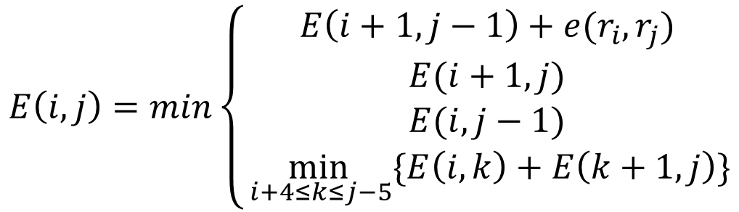
Method Design
$$E\left(i,j\right)=min\left\{\begin{aligned}E\left(i+1,j−1\right)+e(r_{i},r_{j}) \\ E(i+1,j) \\ E(i,j−1) \\ \min_{ i+4≤k≤j−5}{\{E\left(i,k\right)+E\left(k+1,j\right)\}}\end{aligned}\right.$$
Nussinov and Jacobson Model
(Nussinov & Jacobson, 1980)
Notes:
Nussinov and Jacobson model was be used to evaluate the value of each box. There are four cases in the model.
Upper case E(I,j) represents the minimum free energy of the sequence starting from I to j. The value of E, or the maximum amount of h bond in segment from I th nucleotide to j th nucleotide, would be stored in the location (I,j) of the table.
The lower case e is the # of h bond between the two nucleotides.
To truly understand what the model means, let’s look at the example.

Slide 46
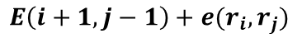
Method Design
j
Case 1
i
G |  |  |  | ?
 | U
 |  | N
 |  |  | C
 |  |  |  | C
 |  |  |  |  | …
 |  |  |  |  |  | …
 |  |  |  |  |  |  | C
 |  |  |  |  |  |  |  | U
 |  |  |  |  |  |  |  |  | N
$$E\left(i+1,j−1\right)+e(r_{i},r_{j})$$
Notes:
Case one is when the first and last nucleotide in the sequence form a base pair.

Slide 47
Method Design
j
Case 1
i
G |  |  |  | ?
 | U |  | 0
 |  | N
 |  |  | C
 |  |  |  | C
 |  |  |  |  | …
 |  |  |  |  |  | …
 |  |  |  |  |  |  | C
 |  |  |  |  |  |  |  | U
 |  |  |  |  |  |  |  |  | N
$$E\left(i+1,j−1\right)+e(r_{i},r_{j})$$
0 +
Notes:
The program first reads in the value in box (i+1, j-1). Since (i+1, j-1) is in the forbidden zone, the value is 0.

Slide 48
Method Design
j
Case 1
i
G |  |  |  | ?
 | U |  | 0
 |  | N
 |  |  | C
 |  |  |  | C
 |  |  |  |  | …
 |  |  |  |  |  | …
 |  |  |  |  |  |  | C
 |  |  |  |  |  |  |  | U
 |  |  |  |  |  |  |  |  | N
Case 1 = -3
$$E\left(i+1,j−1\right)+e(r_{i},r_{j})$$
0 + -3 = -3
Notes:
And when we evaluate the base pairing of G and C, we will get a value of -3. Thus, the total value for case 1 is -3.

Slide 49
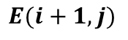
Method Design
j
Case 2
i
G |  |  |  | ?
 | U
 |  | N
 |  |  | C
 |  |  |  | C
 |  |  |  |  | …
 |  |  |  |  |  | …
 |  |  |  |  |  |  | C
 |  |  |  |  |  |  |  | U
 |  |  |  |  |  |  |  |  | N
Case 1 = -3
$$E(i+1,j)$$
Notes:
Case 2 is when the ends don’t form a base pair.

Slide 50
Method Design
j
Case 2
i
G |  |  |  | ?
 | U |  |  | 0
 |  | N
 |  |  | C
 |  |  |  | C
 |  |  |  |  | …
 |  |  |  |  |  | …
 |  |  |  |  |  |  | C
 |  |  |  |  |  |  |  | U
 |  |  |  |  |  |  |  |  | N
Case 1 = -3
Case 2 = 0
$$E(i+1,j)$$
0
Notes:
Therefore, the value is in the box (I+1, j)

Slide 51
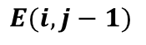
Method Design
j
Case 3
i
G |  |  | 0 | ?
 | U
 |  | N
 |  |  | C
 |  |  |  | C
 |  |  |  |  | …
 |  |  |  |  |  | …
 |  |  |  |  |  |  | C
 |  |  |  |  |  |  |  | U
 |  |  |  |  |  |  |  |  | N
Case 1 = -3
Case 2 = 0
Case 3 = 0
$$E(i,j−1)$$
0
Notes:
Case 3 is similar to case 2, which also has a value of 0.

Slide 52
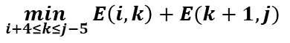
Method Design
j
Case 4
i
G |  |  |  | ?
 | U
 |  | N
 |  |  | C
 |  |  |  | C
 |  |  |  |  | …
 |  |  |  |  |  | …
 |  |  |  |  |  |  | C
 |  |  |  |  |  |  |  | U
 |  |  |  |  |  |  |  |  | N
Case 1 = -3
Case 2 = 0
Case 3 = 0
$$\min_{ i+4≤k≤j−5}{E\left(i,k\right)+E(k+1,j)}$$
Notes:
And lastly, case four.

Slide 53
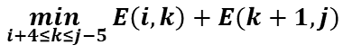
Method Design
j
Case 4
i
G |  |  |  | a |  |  |  |  | a+b
 | U
 |  | N
 |  |  | C
 |  |  |  | C
 |  |  |  |  | … |  |  |  | b
 |  |  |  |  |  | …
 |  |  |  |  |  |  | C
 |  |  |  |  |  |  |  | U
 |  |  |  |  |  |  |  |  | N
Case 1 = -3
Case 2 = 0
Case 3 = 0
$$\min_{ i+4≤k≤j−5}{E\left(i,k\right)+E(k+1,j)}$$
k
Notes:
Case four is when the optimal value for the sequence is the sum of two non-overlapping sequence. And k is the intersecting point of the two triangles.
The highlighted triangles are an example of case four for the entire sequence.

Slide 54
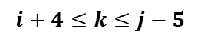
Method Design
j
Case 4
i
G |  |  |  | ?
 | U
 |  | N
 |  |  | C
 |  |  |  | C
 |  |  |  |  | …
 |  |  |  |  |  | …
 |  |  |  |  |  |  | C
 |  |  |  |  |  |  |  | U
 |  |  |  |  |  |  |  |  | N
Case 1 = -3
Case 2 = 0
Case 3 = 0
$$\min_{ i+4≤k≤j−5}{E\left(i,k\right)+E(k+1,j)}$$
$$i+4≤k≤j−5$$
Notes:
However, in the example, the precondition of i+4 less or equal to k and j-5 larger or equal to k won’t be satisfied

Slide 55
Method Design
j
Case 4
i
G |  |  |  | ?
 | U
 |  | N
 |  |  | C
 |  |  |  | C
 |  |  |  |  | …
 |  |  |  |  |  | …
 |  |  |  |  |  |  | C
 |  |  |  |  |  |  |  | U
 |  |  |  |  |  |  |  |  | N
Case 1 = -3
Case 2 = 0
Case 3 = 0
$$\min_{ i+4≤k≤j−5}{E\left(i,k\right)+E(k+1,j)}$$
i=0
$$i+4≤k≤j−5$$
𝟎 + 𝟒 ≤ 𝒌 ≤ 4 − 𝟓
j=4
Notes:
However, in the example, the precondition of i+4 less or equal to k and j-5 larger or equal to k won’t be satisfied

Slide 56
Method Design
j
Case 4
i
G |  |  |  | ?
 | U
 |  | N
 |  |  | C
 |  |  |  | C
 |  |  |  |  | …
 |  |  |  |  |  | …
 |  |  |  |  |  |  | C
 |  |  |  |  |  |  |  | U
 |  |  |  |  |  |  |  |  | N
Case 1 = -3
Case 2 = 0
Case 3 = 0
Case 4 = 0
$$\min_{ i+4≤k≤j−5}{E\left(i,k\right)+E(k+1,j)}$$
i=0
$$i+4≤k≤j−5$$
𝟎 + 𝟒 ≤ 𝒌 ≤ 4 − 𝟓
𝟒 ≤ 𝒌 ≤ −1
j=4
Notes:
However, in the example, the precondition of i+4 less or equal to k and j-5 larger or equal to k won’t be satisfied

Slide 57
Method Design
j
Case 4
i
G |  |  |  | ?
 | U
 |  | N
 |  |  | C
 |  |  |  | C
 |  |  |  |  | …
 |  |  |  |  |  | …
 |  |  |  |  |  |  | C
 |  |  |  |  |  |  |  | U
 |  |  |  |  |  |  |  |  | N
Case 1 = -3
Case 2 = 0
Case 3 = 0
Case 4 = 0
$$\min_{ i+4≤k≤j−5}{E\left(i,k\right)+E(k+1,j)}$$
i=0
$$i+4≤k≤j−5$$
𝟎 + 𝟒 ≤ 𝒌 ≤ 4 − 𝟓
𝟒 ≤ 𝒌 ≤ −1
0
j=4
Notes:
However, in the example, the precondition of i+4 less or equal to k and j-5 larger or equal to k won’t be satisfied

Slide 58
Method Design
j
i
G |  |  |  | ?
 | U
 |  | N
 |  |  | C
 |  |  |  | C
 |  |  |  |  | …
 |  |  |  |  |  | …
 |  |  |  |  |  |  | C
 |  |  |  |  |  |  |  | U
 |  |  |  |  |  |  |  |  | N
Case 1 = -3
Case 2 = 0
Case 3 = 0
Case 4 = 0
Notes:
Read in virus sequence
Explain why two locations are changed to proline -> confounding variable

Slide 59
Method Design
j
i
G |  |  |  | ?
 | U
 |  | N
 |  |  | C
 |  |  |  | C
 |  |  |  |  | …
 |  |  |  |  |  | …
 |  |  |  |  |  |  | C
 |  |  |  |  |  |  |  | U
 |  |  |  |  |  |  |  |  | N
Case 1 = -3
Case 2 = 0
Case 3 = 0
Case 4 = 0
Notes:
Read in virus sequence
Explain why two locations are changed to proline -> confounding variable

Slide 60
Method Design
j
i
G |  |  |  | -3
 | U
 |  | N
 |  |  | C
 |  |  |  | C
 |  |  |  |  | …
 |  |  |  |  |  | …
 |  |  |  |  |  |  | C
 |  |  |  |  |  |  |  | U
 |  |  |  |  |  |  |  |  | N
Case 1 = -3
Case 2 = 0
Case 3 = 0
Case 4 = 0

Slide 61
Method Design
j
i
G |  |  |  | -3
 | U
 |  | N
 |  |  | C
1 |  |  |  | C
 |  |  |  |  | …
 |  |  |  |  |  | …
 |  |  |  |  |  |  | C
 |  |  |  |  |  |  |  | U
 |  |  |  |  |  |  |  |  | N
Case 1 = -3
Case 2 = 0
Case 3 = 0
Case 4 = 0
Notes:
When which case at position (I,j) is optimal is determined, a case code was assigned to (j,i) in the table for backtracing. In this case, 1 would assigned as case 1 was optimal.

Slide 62
Method Design
j
i
G |  |  |  | -3
 | U |  |  |  | …
 |  | N |  |  |  | …
 |  |  | C |  |  |  | -14
1 |  |  |  | C |  |  |  | -14
 | … |  |  |  | … |  |  |  | …
 |  | … |  |  |  | …
 |  |  | 1 |  |  |  | C
 |  |  |  | 1 |  |  |  | U
 |  |  |  |  | … |  |  |  | N

Slide 63
Method Design
j
i
G |  |  |  | -3 | …
 | U |  |  |  | … | …
 |  | N |  |  |  | … | -17
 |  |  | C |  |  |  | -14 | -14
1 |  |  |  | C |  |  |  | -14 | -17
… | … |  |  |  | … |  |  |  | …
 | … | … |  |  |  | …
 |  | 0 | 1 |  |  |  | C
 |  |  | 1 | 1 |  |  |  | U
 |  |  | 1 | 1 | … |  |  |  | N

Slide 64
Method Design
j
i
G |  |  |  | -3 | … | …
 | U |  |  |  | … | … | -17
 |  | N |  |  |  | … | -17 | -17
 |  |  | C |  |  |  | -14 | -14 | -17
1 |  |  |  | C |  |  |  | -14 | -17
… | … |  |  |  | … |  |  |  | …
… | … | … |  |  |  | …
 | 1 | 0 | 1 |  |  |  | C
 |  | 2 | 1 | 1 |  |  |  | U
 |  |  | 1 | 1 | … |  |  |  | N

Slide 65
Method Design
j
i
G |  |  |  | -3 | … | … | -19
 | U |  |  |  | … | … | -17 | -17
 |  | N |  |  |  | … | -17 | -17 | -18
 |  |  | C |  |  |  | -14 | -14 | -17
1 |  |  |  | C |  |  |  | -14 | -17
… | … |  |  |  | … |  |  |  | …
… | … | … |  |  |  | …
0 | 1 | 0 | 1 |  |  |  | C
 | 1 | 2 | 1 | 1 |  |  |  | U
 |  | 4 | 1 | 1 | … |  |  |  | N

Slide 66
Method Design
j
i
G |  |  |  | -3 | … | … | -19 | -19
 | U |  |  |  | … | … | -17 | -17 | -19
 |  | N |  |  |  | … | -17 | -17 | -18
 |  |  | C |  |  |  | -14 | -14 | -17
1 |  |  |  | C |  |  |  | -14 | -17
… | … |  |  |  | … |  |  |  | …
… | … | … |  |  |  | …
0 | 1 | 0 | 1 |  |  |  | C
2 | 1 | 2 | 1 | 1 |  |  |  | U
 | 1 | 4 | 1 | 1 | … |  |  |  | N

Slide 67
Method Design
j
i
G |  |  |  | -3 | … | … | -19 | -19 | -20
 | U |  |  |  | … | … | -17 | -17 | -19
 |  | N |  |  |  | … | -17 | -17 | -18
 |  |  | C |  |  |  | -14 | -14 | -17
1 |  |  |  | C |  |  |  | -14 | -17
… | … |  |  |  | … |  |  |  | …
… | … | … |  |  |  | …
0 | 1 | 0 | 1 |  |  |  | C
2 | 1 | 2 | 1 | 1 |  |  |  | U
1 | 1 | 4 | 1 | 1 | … |  |  |  | N

Slide 68
Method Design
Backtrace
Notes:
After the entire table is filled up, the program backtraced using the lower half of the case codes.

Slide 69
Method Design
7-letter 4-letter
Backtrace
Base Pair & First Rank Codon
Notes:
The backtracing process converted the 7-letter nucleotide involved in base pairing back to 4-letter nucleotide. However, there were leftover 7-letter nucleotide as not all of them were involved in base-pairing. Then, the program replaced the codon the leftover 7-letter is in with 4-letter first rank codon to maximize the CAI value.

Slide 70
Method Design
RNAfold & EMBOSS
7-letter 4-letter
Notes:
The modified sequence is then put into RNAfold by University of Vienna to calculate MFE and EMBOSS, a python bioinformatics package, to calculate CAI.

Slide 71
02.
Results & Analysis
Notes:
And that will lead us to the results section.

Slide 72
Results & Analysis
VIRUS
MODIFIED SEQUENCE
PFIZER VACCINE
MFE: -1072.20 kcal/mol
CAI: 0.646
MFE: -1708.50 kcal/mol
CAI: 0.829
MFE: -1321.30 kcal/mol
CAI: 0.944
Notes:
The results show that the 7-letter scoring scheme was able to achieve a lower MFE but not able to improve the CAI.

Slide 73
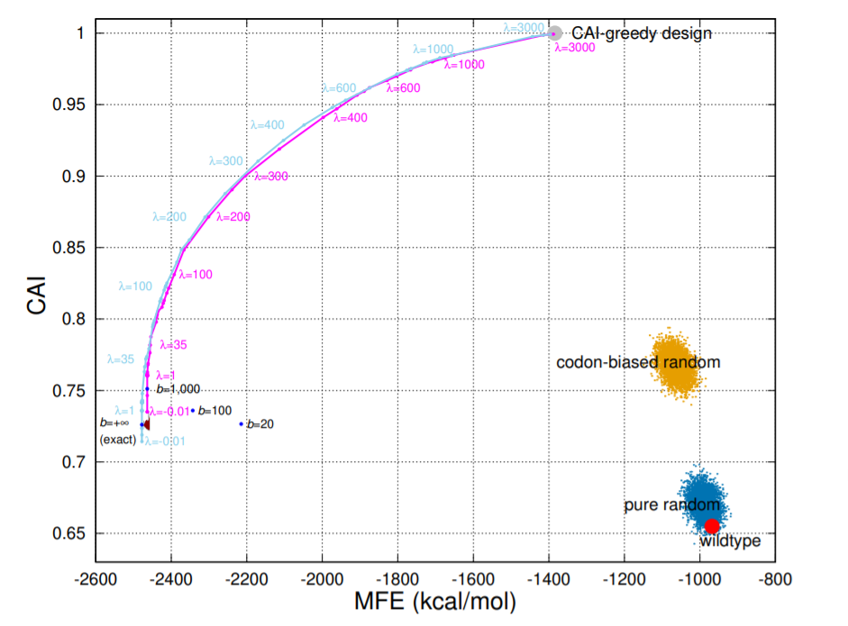
Results & Analysis
LinearDesign: Efficient Algorithms for Optimized mRNA Sequence Design
(Zhang et al., 2020)
Notes:
This is a graph from the paper “LinearDesign: Efficient Algorithms for Optimized mRNA Sequence Design” by Zhang et al. The x axis is for MFE and the y axis is for the CAI.

Slide 74
Results & Analysis
Notes:
We want to specifically focus the region under the curve as it represents where a feasible RNA sequence could lie in the graph.

Slide 75
Results & Analysis
Pfizer
Modified Sequence
Notes:
As you can see, the 7-letter modified sequence is under the curve, thus it is feasible. Comparing to the Pfizer, the 7-letter modified sequence is more balanced, while the Pfizer vaccine is more CAI-greedy.

Slide 76
Results & Analysis
VIRUS
&
PFIZER VACCINE
MODIFIED SEQUENCE
&
PFIZER VACCINE
72.18%
83.82%
Notes:
When I compared how many nucleotides are the same in virus and Pfizer, it turned out that there are the same about 72.18%, while the 7-letter modified sequence is 83.82% the same to the Pfizer vaccine. This indicates that both Pfizer and 7-letter have similar design objectives.

Slide 77
03.
Conclusion

Slide 78
Conclusion
Research Question: How could 7-Letter Scoring Scheme implemented in Nussinov and Jacobson model optimize the Minimum Free Energy and Codon Adaptation Index of mRNA COVID-19 vaccine designs?
Theoretically, the implementation of 7-letter scoring scheme is able to optimize the MFE but not the CAI of mRNA vaccine designs comparing to the Pfizer mRNA COVID-19 vaccine.

Slide 79
04.
Limitations & Implications
Notes:
And that will lead us to the results section.

Slide 80
Limitations
Pseudoknots
Inhibit Protein activities
Stimulate -1 Frameshift
(Giedroc & Cornish, 2009)
Notes:
The current model doesn’t take in account for the existence of pseudoknots. However, in reality, pseudoknots inhibit protein activities and stimulate -1 frameshifts.

Slide 81
Limitations
Pseudoknots
Inhibit Protein activities
Stimulate -1 Frameshift
(Giedroc & Cornish, 2009)
Sample Size
Resources
Notes:
Another limitation is the sample of the research. Since the sequence is kept secret to each company, resources are largely unavailable. The research could be benefited if there are more vaccine sequence available.

Slide 82
Limitations
Pseudoknots
Inhibit Protein activities
Stimulate -1 Frameshift
(Giedroc & Cornish, 2009)
Sample Size
Resources
RNAfold
Mathews, Sabina, Zuker, & Turner, 1999
Accuracy
Notes:
The MFE calculation on the RNAfold website uses the model proposed by Mathew….. . This model is mostly accurate when the length of sequence is less than 700, while larger sequence will be less accurate. It would be beneficial if there is more than one model to calculate MFE.

Slide 83
Limitations
Pseudoknots
Inhibit Protein activities
Stimulate -1 Frameshift
(Giedroc & Cornish, 2009)
Sample Size
Resources
RNAfold
Mathews, Sabina, Zuker, & Turner, 1999
Accuracy
Theory
Modelling
Testing
Notes:
Lastly, the results of this research is solely limited to theory, as all of them are from modelling. Further testing in real life is needed to make a conclusive conclusion.

Slide 84
Implications
72% 84%
Notes:
Since the similarity with the Pfizer vaccine increased after running the viral sequence in 7-letter scoring scheme, it is reasonable to believe that there are similarities between the design objectives of the 7-letter scoring scheme and the Pfizer vaccine.

Slide 85
Implications
72% 84%
Design Objectives
Notes:
Since the vaccine design objectives are kept secret, this research helps bring understanding of how vaccines are designed to the public.

Slide 86
References
André, S., Seed, B., Eberle, J., Schraut, W., Bültmann, A., & Haas, J. J. J. o. v. (1998). Increased immune response elicited by DNA vaccination with a synthetic gp120 sequence with optimized codon usage. 72(2), 1497-1503.
Bellman, R. J. S. (1966). Dynamic programming. 153(3731), 34-37.
Giedroc, D. P., & Cornish, P. V. J. V. r. (2009). Frameshifting RNA pseudoknots: structure and mechanism. 139(2), 193-208.
Mathews, D. H., Sabina, J., Zuker, M., & Turner, D. H. J. J. o. m. b. (1999). Expanded sequence dependence of thermodynamic parameters improves prediction of RNA secondary structure. 288(5), 911-940.
Nussinov, R., & Jacobson, A. B. J. P. o. t. N. A. o. S. (1980). Fast algorithm for predicting the secondary structure of single-stranded RNA. 77(11), 6309-6313.
Trotta, E. J. P. o. (2014). On the normalization of the minimum free energy of RNAs by sequence length. 9(11), e113380.
Zhang, H., Zhang, L., Li, Z., Liu, K., Liu, B., Mathews, D. H., & Huang, L. J. a. p. a. (2020). LinearDesign: Efficient Algorithms for Optimized mRNA Sequence Design.

Slide 87
Reverse Engineering: A Quantitative Analysis on the 7-Letter Scoring Scheme’s Efficacy in Vaccine Designs
Junyou (Simon) Li
Notes:
Thank you for listening. The floor is now open for question.

Slide 88
Results
Pfizer
Modified Sequence
Notes:
The modified sequence has a MFE value of …. While the Pfizer vaccine has a ….. . To put the values into perspectives, here is a graph.

